Slide 1
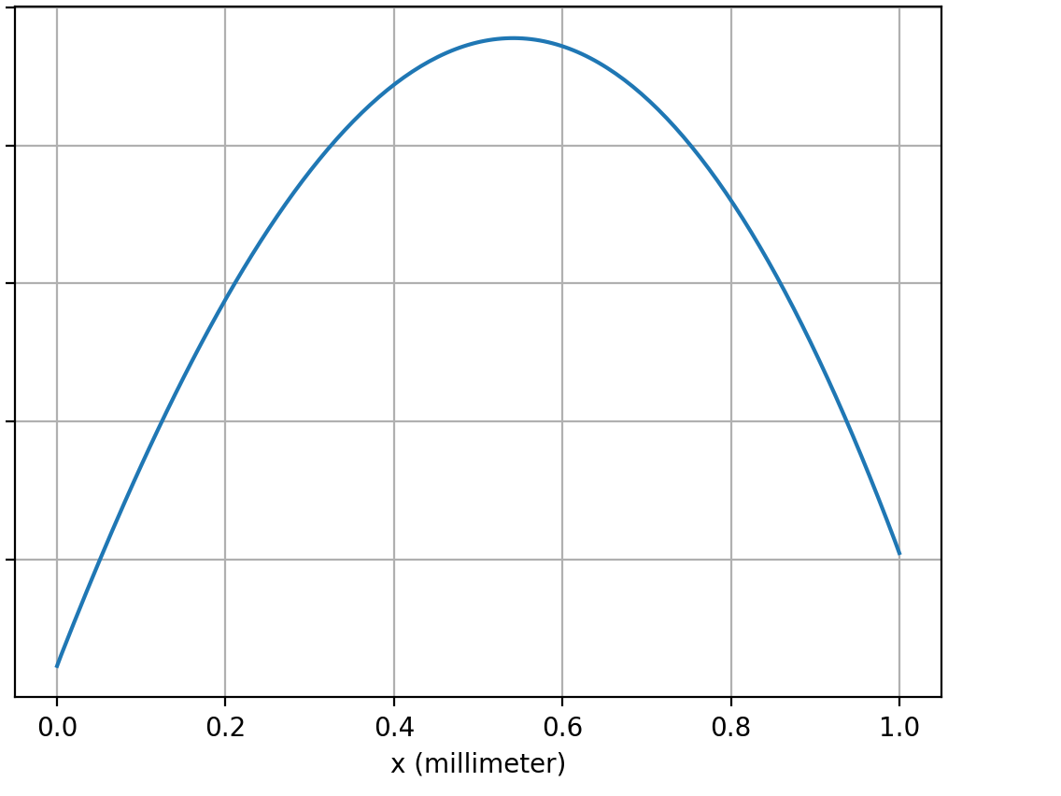
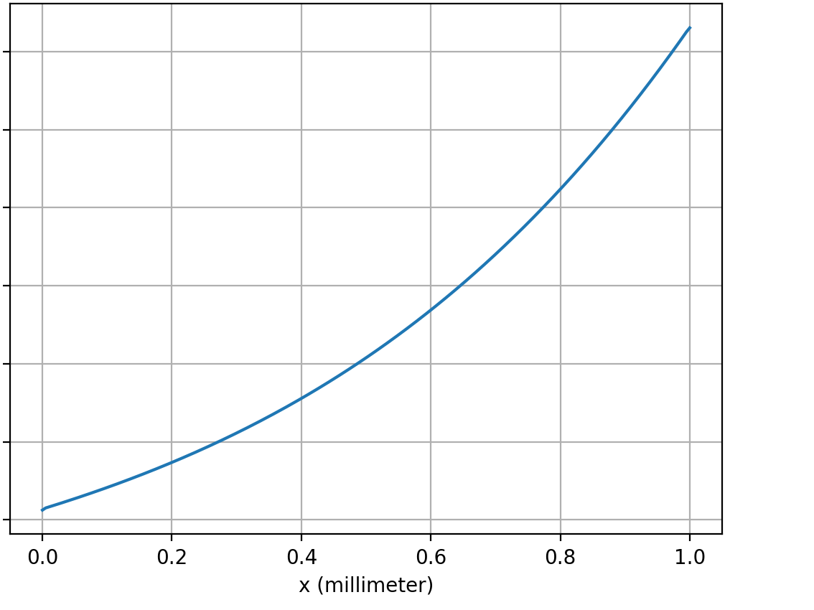
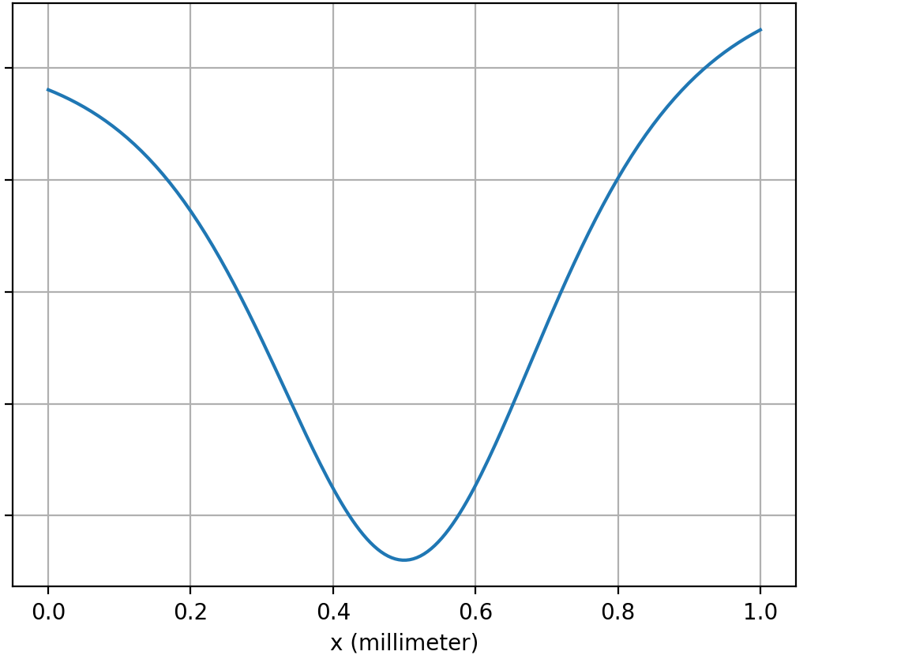

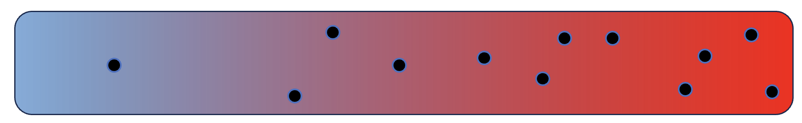

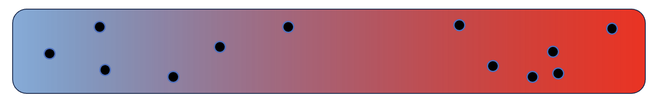



Week 14 – Matching thermophoresis to ${∆U}_{sol}$
$${∆U}_{sol}$$
$${∆U}_{sol}$$
$${∆U}_{sol}$$
A, B, C, D
A, B, C, D
A, B, C, D
A
C
B
D

Slide 2
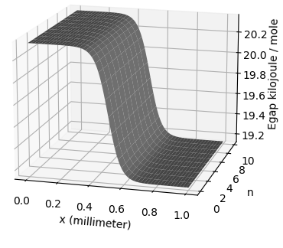
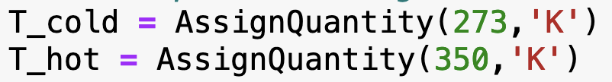

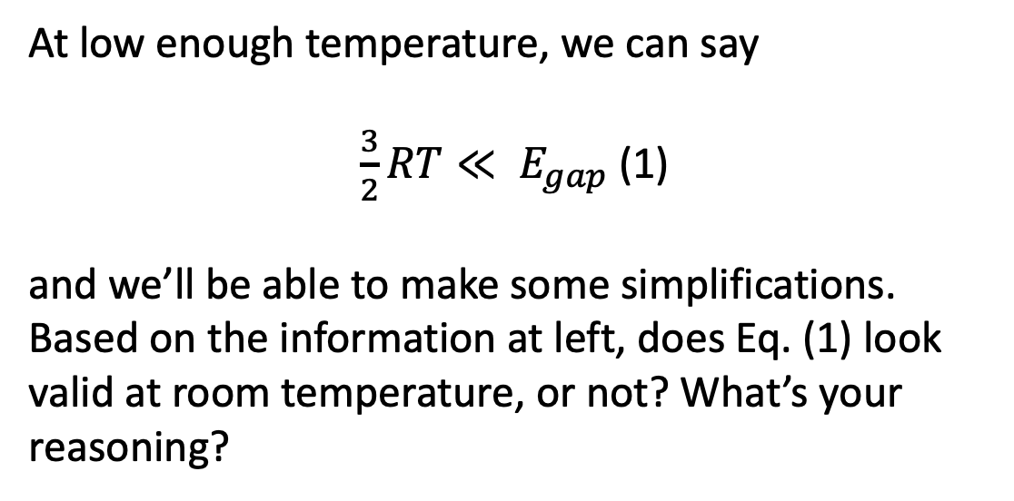


Week 14 – $E_{gap}$ and temperature
$$E_{gap}$$
At low enough temperature, we can say
$\frac{3}{2}RT≪ E_{gap}$ (1)
and we’ll be able to make some simplifications. Based on the information at left, does Eq. (1) look valid at room temperature, or not? What’s your reasoning?
$$∆T=T_{hot}−T_{cold}$$
$T\left(x\right)=T_{cold}+\frac{∆T}{L}x$

Slide 3
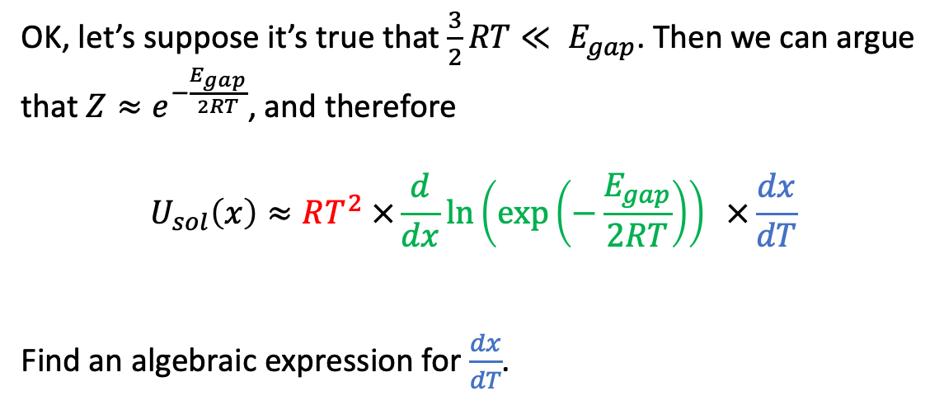
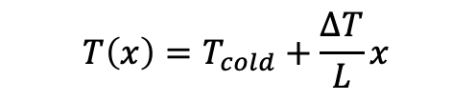
Week 14 – Derivation of $U_{sol}$ (#1)
OK, let’s suppose it’s true that $\frac{3}{2}RT≪ E_{gap}$. Then we can argue that ${Z≈e}^{−\frac{E_{gap}}{2RT}}$, and therefore
$$U_{sol}\left(x\right)≈RT^{2} ×\frac{d}{dx}\ln\left(\exp\left(−\frac{E_{gap}}{2RT}\right)\right) ×\frac{dx}{dT}$$
Find an algebraic expression for $\frac{dx}{dT}$.
$$E_{gap}$$
$$∆T=T_{hot}−T_{cold}$$
$$T\left(x\right)=T_{cold}+\frac{∆T}{L}x$$

Slide 4
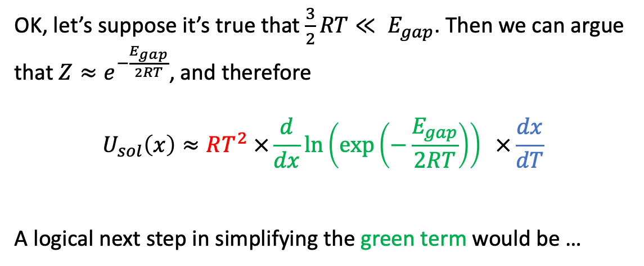
Week 14 – Derivation of $U_{sol}$ (#2)
OK, let’s suppose it’s true that $\frac{3}{2}RT≪ E_{gap}$. Then we can argue that ${Z≈e}^{−\frac{E_{gap}}{2RT}}$, and therefore
$$U_{sol}\left(x\right)≈RT^{2} ×\frac{d}{dx}\ln\left(\exp\left(−\frac{E_{gap}}{2RT}\right)\right) ×\frac{dx}{dT}$$
A logical next step in simplifying the green term would be …
$$E_{gap}$$
$$∆T=T_{hot}−T_{cold}$$
$$T\left(x\right)=T_{cold}+\frac{∆T}{L}x$$

Slide 5
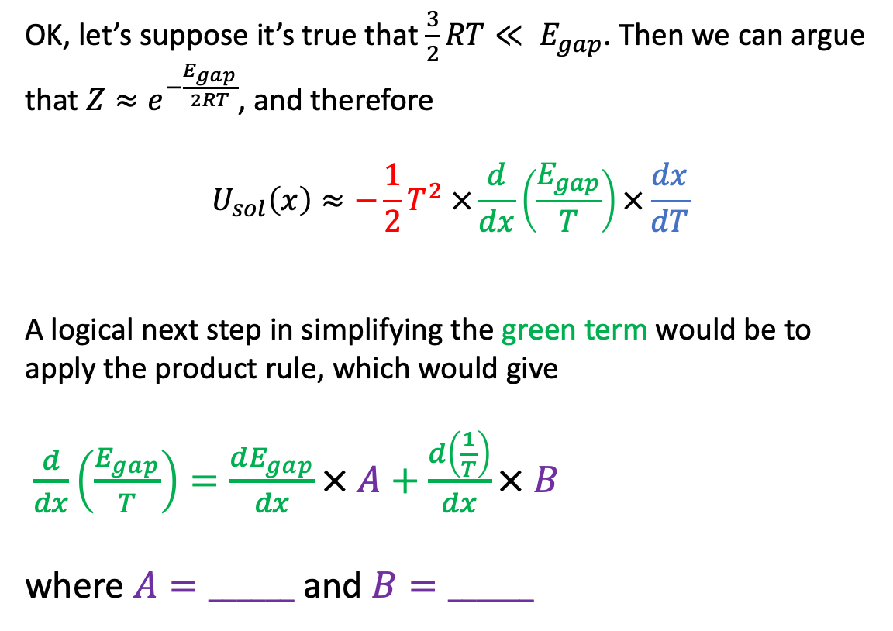
Week 14 – Derivation of $U_{sol}$ (#3)
OK, let’s suppose it’s true that $\frac{3}{2}RT≪ E_{gap}$. Then we can argue that ${Z≈e}^{−\frac{E_{gap}}{2RT}}$, and therefore
$$U_{sol}\left(x\right)≈−\frac{1}{2}T^{2} ×\frac{d}{dx}\left(\frac{E_{gap}}{T}\right)×\frac{dx}{dT}$$
A logical next step in simplifying the green term would be to apply the product rule, which would give
$\frac{d}{dx}\left(\frac{E_{gap}}{T}\right)=\frac{dE_{gap}}{dx}× A+\frac{d\left(\frac{1}{T}\right)}{dx}× B$
where $A=______$ and $B=______$
$$E_{gap}$$
$$∆T=T_{hot}−T_{cold}$$
$$T\left(x\right)=T_{cold}+\frac{∆T}{L}x$$

